Slide 1

BDAT 1008 Final Project
By;
Abdul-Baatinul-Haad Yusuf
Athul Verghese
Milind Satishkumar Tank
Deepak Thalian

Slide 2



Agenda
Introduction
About Dataset
Business Aspects
Technologies used
Visualization
Screenshots of Codes
Conclusion

Slide 3




Introduction
This group has undertaken this project to enlighten the masses in Toronto, Canada about past, present, and future rates of crime around them. With this project, we will showcase visuals about the types of crime that usually occur and the rates at which they occur. The project will be made available to the masses on a hosted website. This will enable current, and potential people looking to stay in Toronto, view the safest areas. It may also serve as an aid to the Government or police forces to pay attention to hot zones of various crimes and prepare themselves to handle any sudden reports.

Slide 4

About Dataset
The dataset includes all Major Crime Indicators occurrences by reported date and related offence from 2014 – 2021.
The Major Crime Indicators categories include Assault, Break and Enter, Auto Theft, Robbery, and Theft Over. Excludes Sexual Violence.
The dataset has 281,692 rows with 31 columns. This is considered a relatively large amount of data.
Link to dataset - https://data.torontopolice.on.ca/datasets/TorontoPS::major-crime-indicators-1/explore?location=20.514081%2C-40.019598%2C4.81&showTable=true
Major Crime Indicators in Toronto

Slide 5
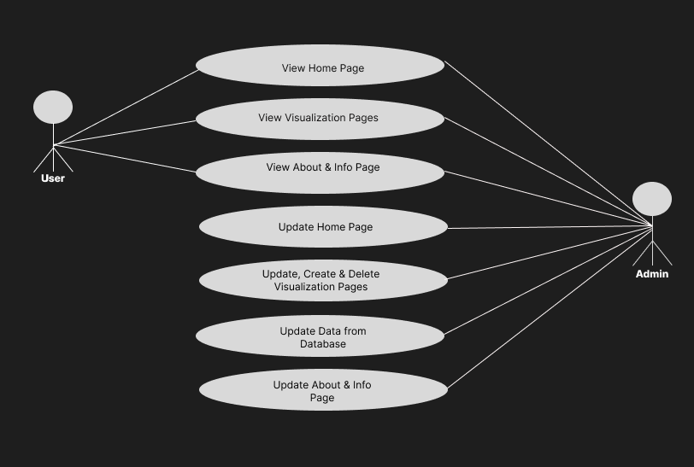
Business Aspects
Actors/Use cases
Business Cases / Questions
There are 2 main actors in our project, the general users of the dashboards, and the admins.
Which Major Crime Indicators occur the most and the least?
Which top 10 Neighbourhoods has the highest occurrence for crimes?
What year has seen the highest number of MCIs?
What Premises type has the highest and lowest occurrence of crimes?
Which top 10 Neighbourhoods has the highest occurrence for crimes based on the MCIs?
What Premises type has the highest and lowest occurrence of crimes based on the MCIs?
A map showing the Neighbourhoods and the total crime occurrences based on premises type.

Slide 6









Technologies Used

Slide 7
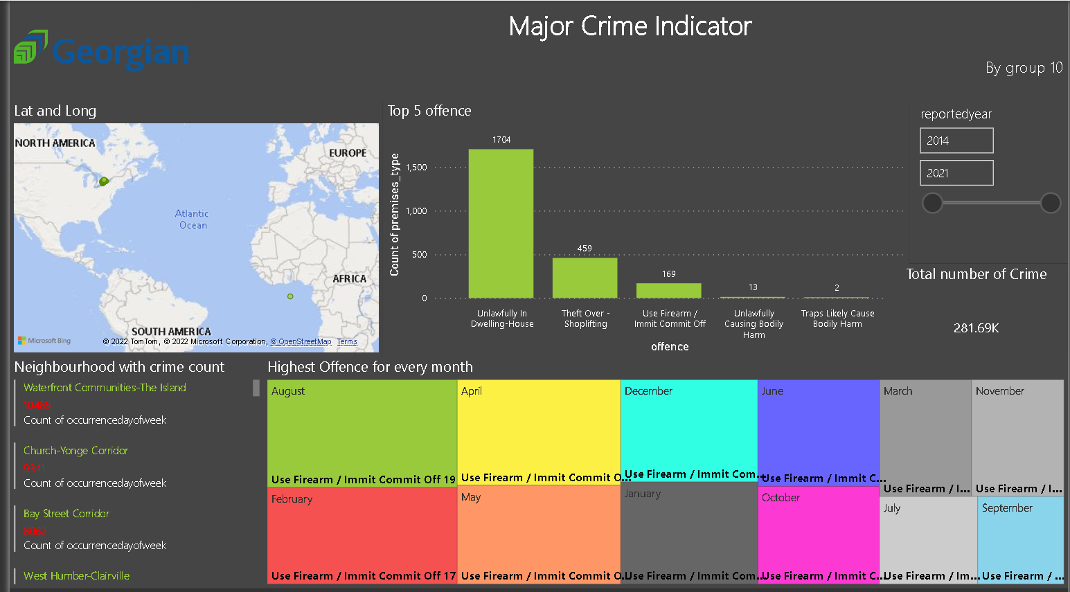
Visualization
With Power BI

Slide 8
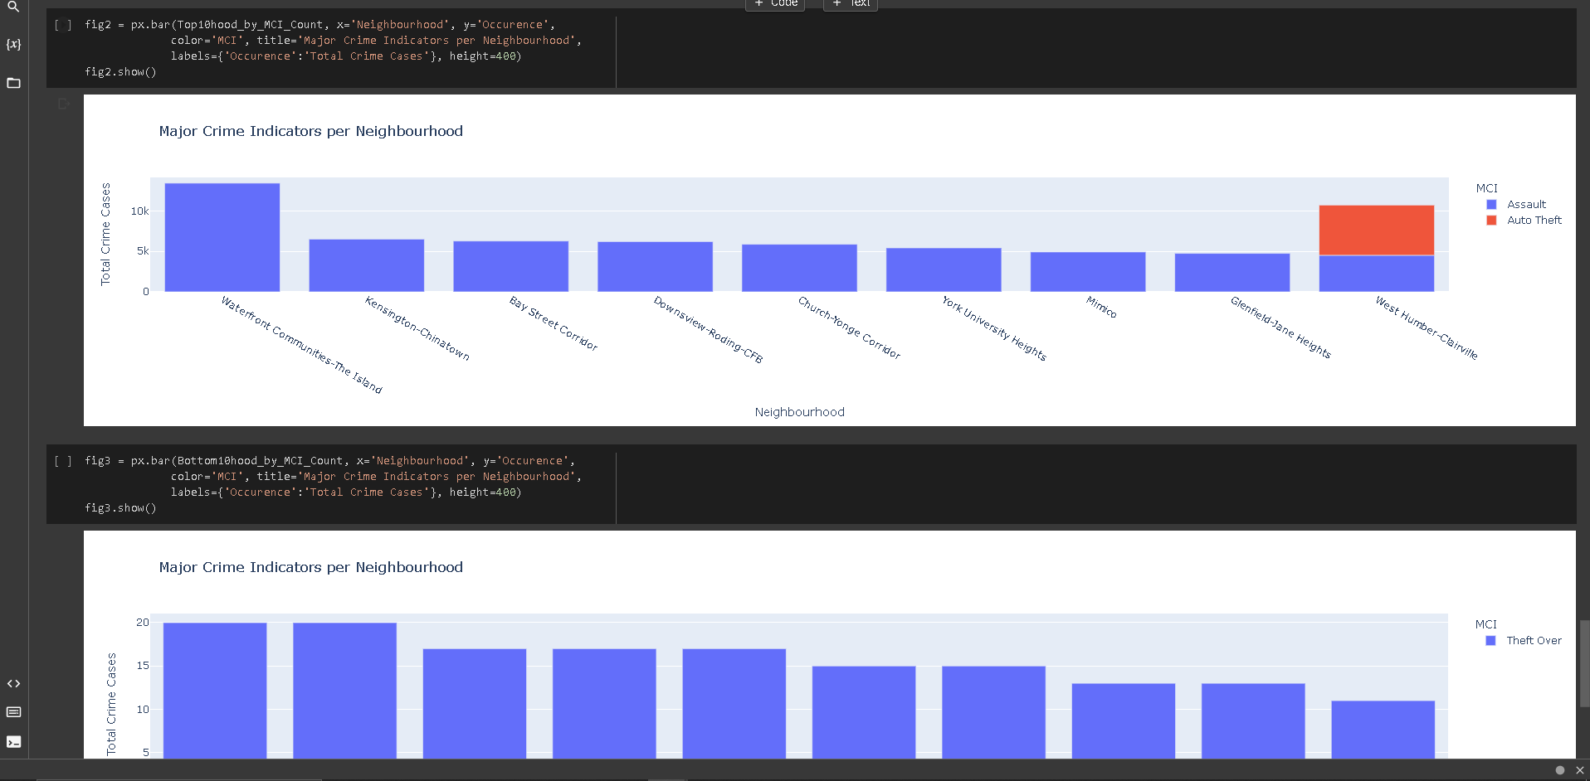
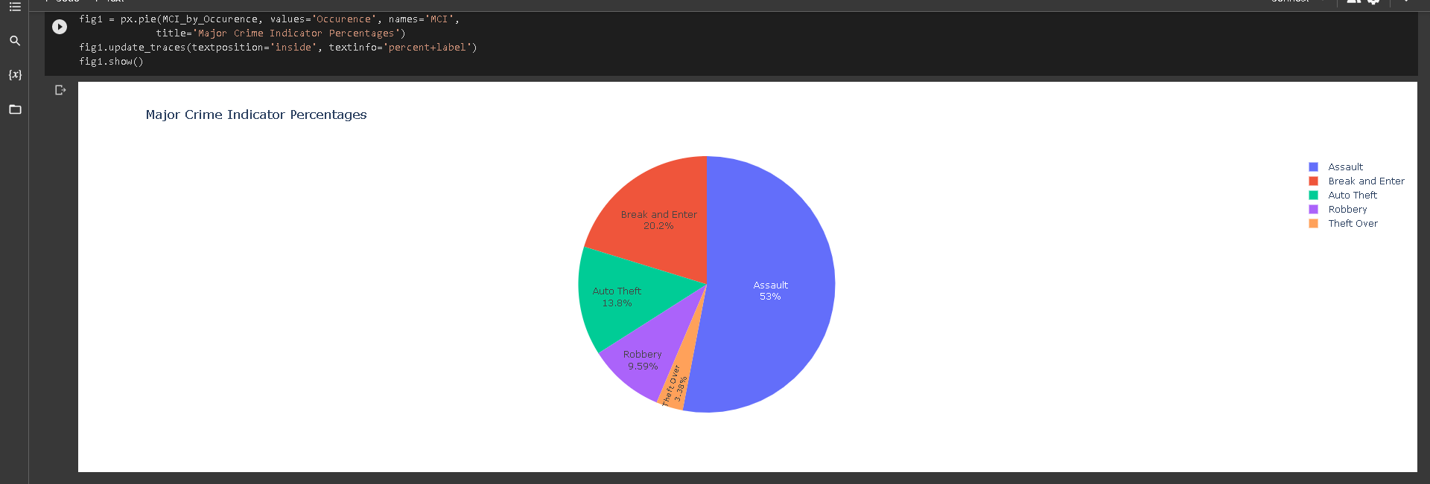
Visualization
With Google Colab and Plotly

Slide 9
DEMO

Slide 10

Summary
The Dashboards created are intended to provide communities with interactive information regarding public safety and awareness. We hope it brings a positive impact in terms of the police force being actively alert and prevent any crime that may occur.

Slide 11
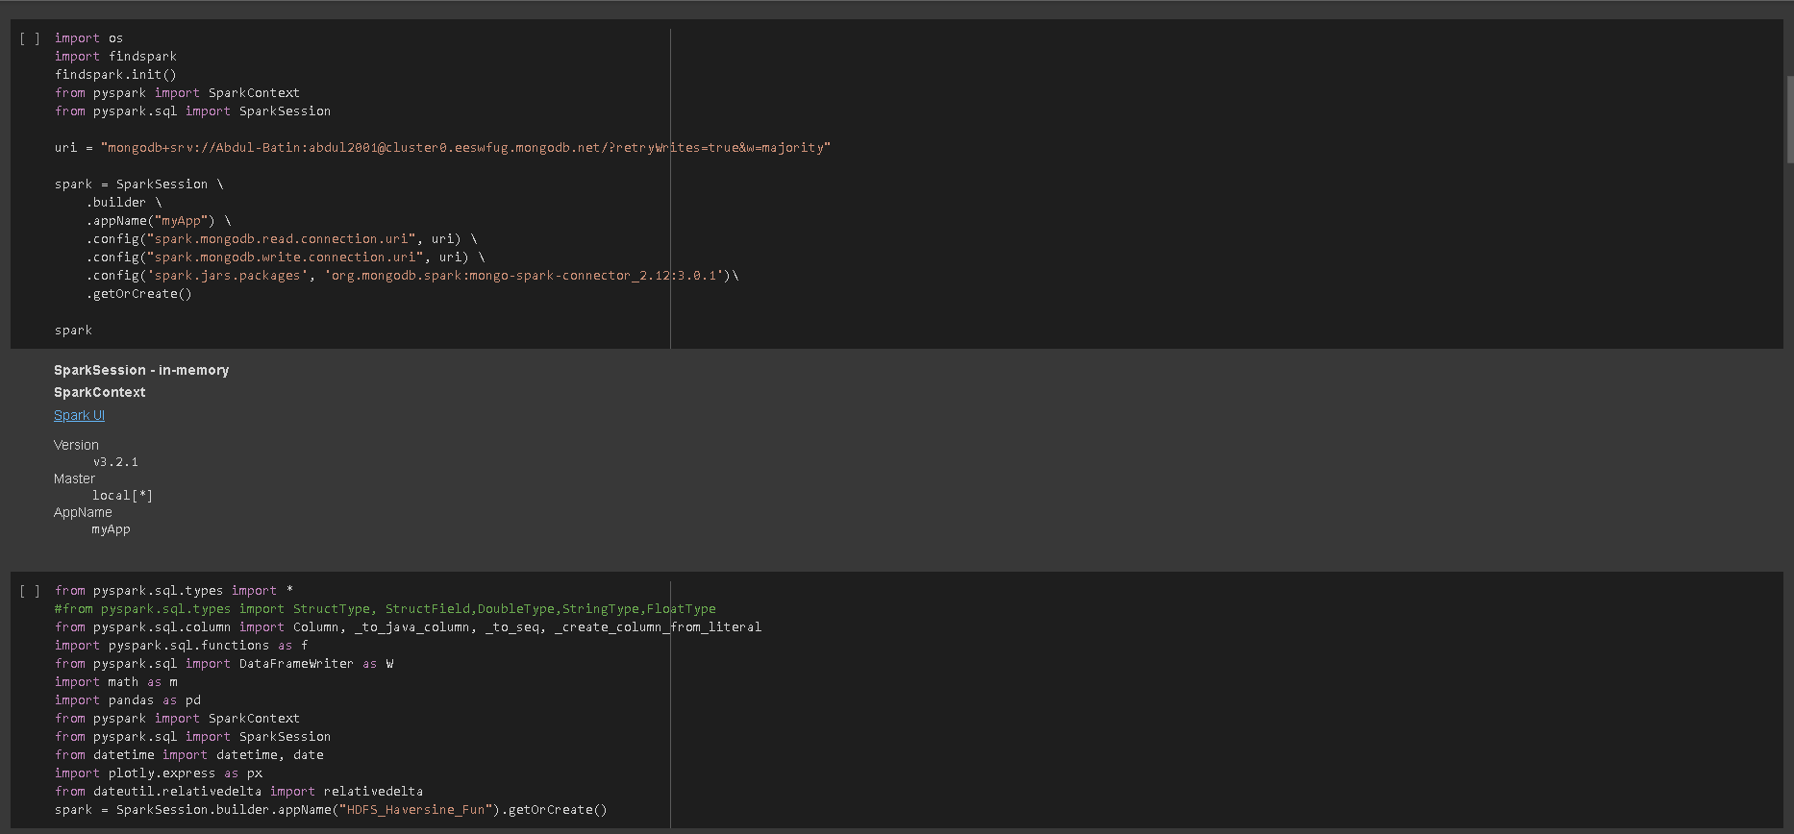
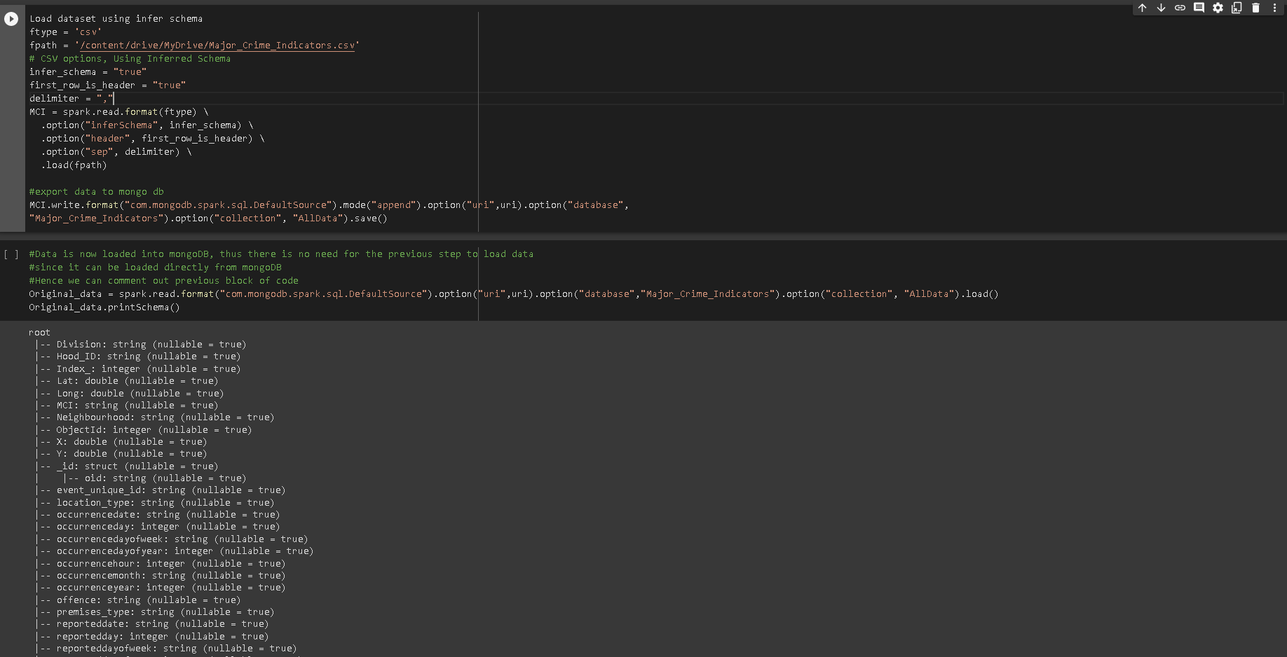
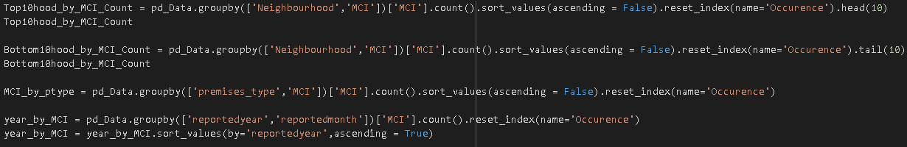
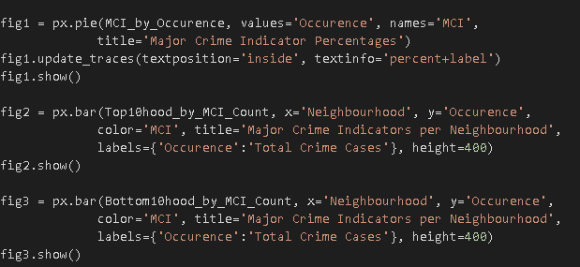
Code Snapshots
Environment Set-up
Mongo Db Export and Import of Database
Data Manipulation
Data Visualization on Google colab

Slide 12
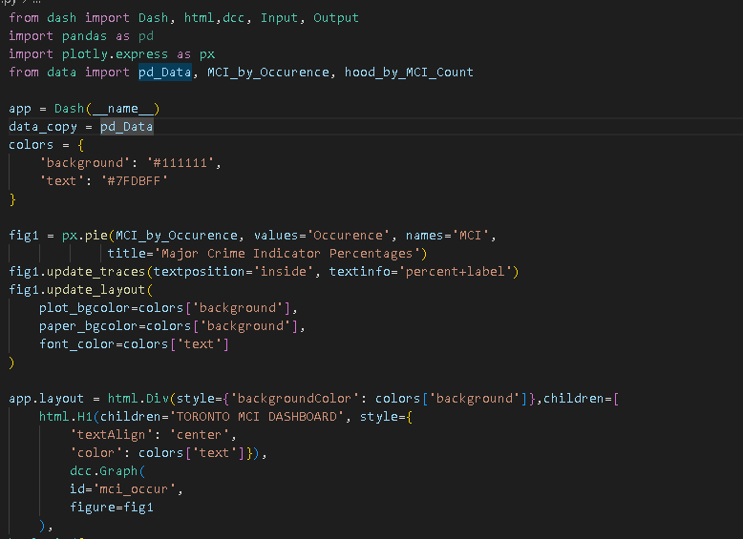
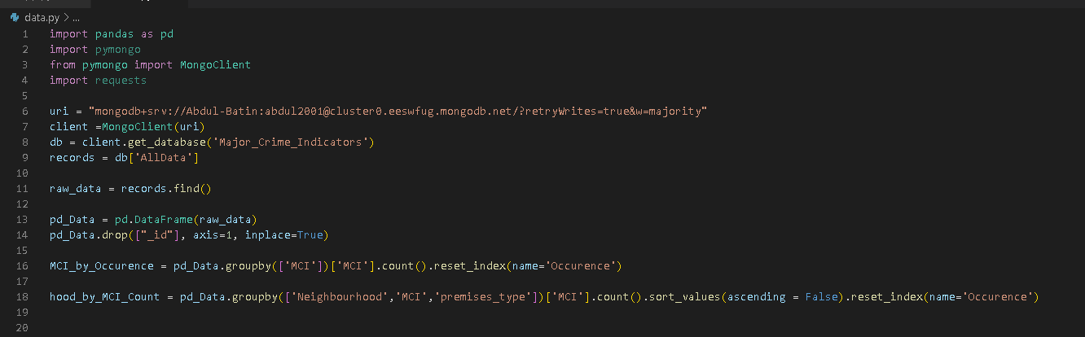
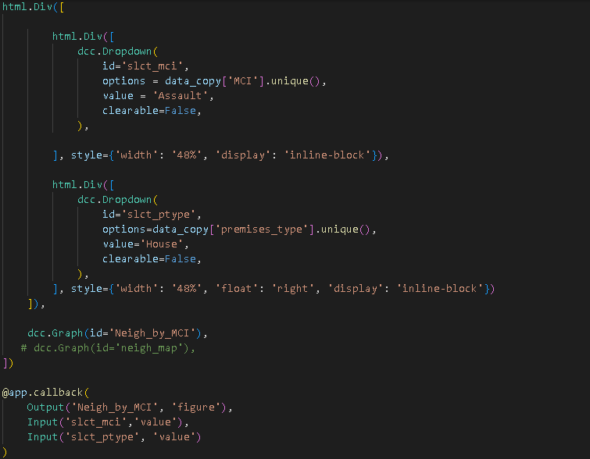
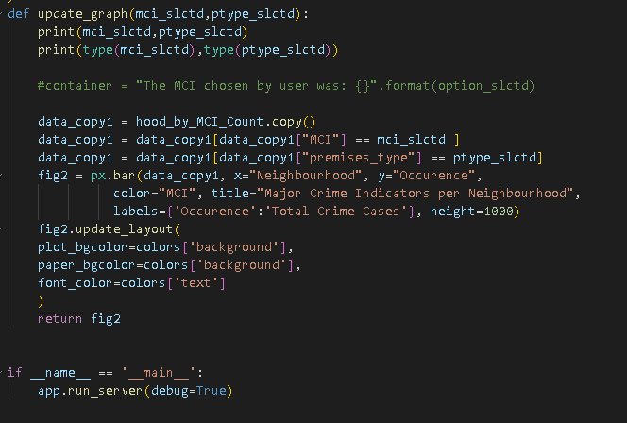
Code Snapshots Contd.
Data Import into VS Code
Web App Creation

Slide 13


Thank You
Presented By: Team 10

